Slide 1
HTML and CSS
Introduction

Slide 2
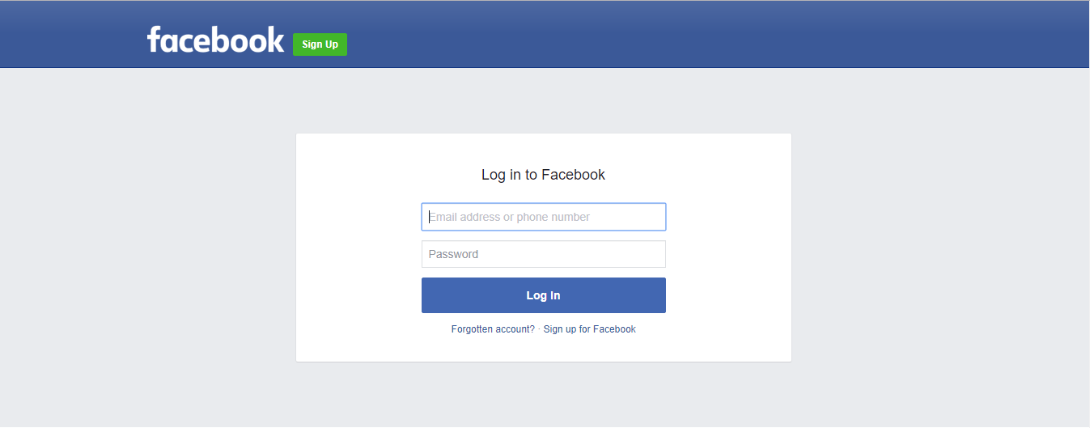
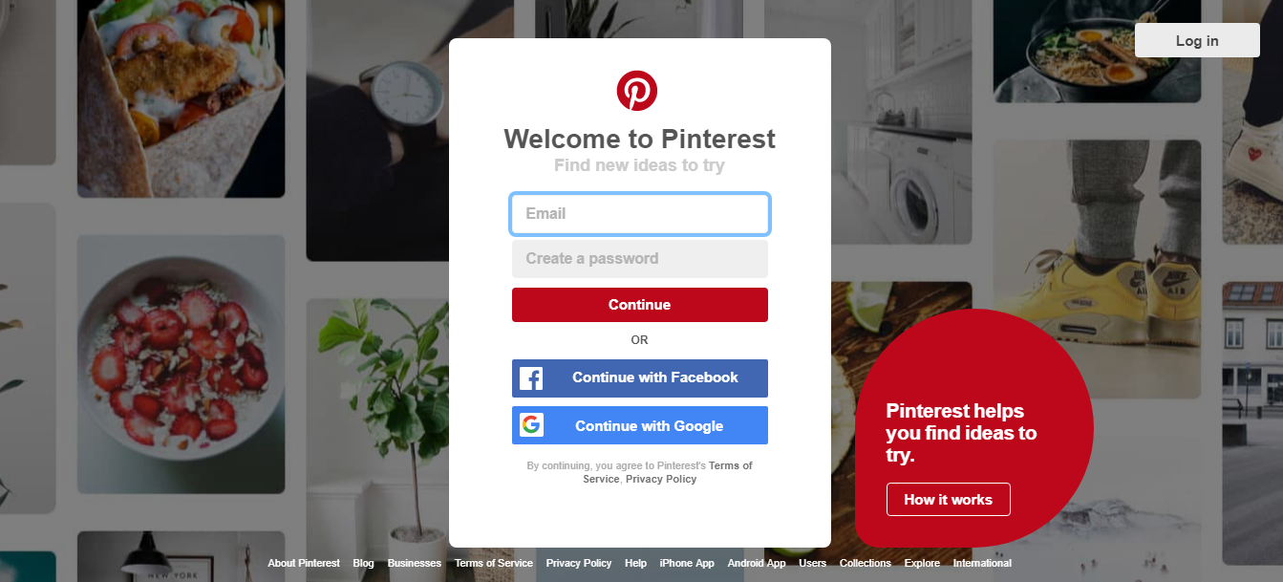
Everywhere HTML and CSS!!!
Notes:
Welcome to this class on HTML. We live in a time when websites have become part of our everyday lives, replacing newspapers and books, and offering users a whole range of new opportunities. Through websites we meet new people, make a living, we shop, play games, check news and many more. In this first module we are going to talk about HTML and how it fits into the World Wide Web. We will first talk a little about the history of HTML and the focus on what an HTML document is and some of the root elements and things that we need to concerned about.

Slide 3


World Wide Web
Notes:
Talking about the history of HTML we need to understand why it was build. We know internet allows different computers all around the world to be connected. And this includes all sort of things like TCPIP, DNS, name resolution, an IP addresses, all that good low level stuff that allows the computers to be connected. And it was all generated back for defense so they could connect their computers and share information. Now on top of that we had the World Wide Web which was essentially created by this man, Tim Berners-Lee and the Web, the World Wide Web is actually made up of a few different things.
HTML is the language that we use to create documents that we want to share across the World Wide Web or more appropriately across the internet. We want to share these documents using this underlying network topology.

Slide 4

HTML Page
Notes:
Another piece of that is the notion of a universal resource identifying or universal resource locator, the URI or URL. You can see here down by our document we have an address for a particular HTML document. That's a big piece of the Web is being able to go out and use an address to get a particular document that we're interested in. And finally if we watch our HTML document we have the HTTP protocol, hypertext transfer protocol which is all about taking those documents and exchanging them at layers on top of the internet protocols and provides us a language for exchanging these documents. So HTML hypertext markup language, http the hypertext transfer protocol. HTML documents was created with the intent to share documents. Specifically research documents that people had created and for better understandability would have text, images, charts and most importantly they need to be linked together. Which means If I am creating a research document and if I want to reference someone else’s work I just need to click on the link to take me to that document on the World Wide Web.
HTML really is a markup language. We're going to create our documents, mark them up with these tags or this meta information and then it's meant to be processed by a client application
So HTML is simply a set of tags we use to describe to the browser how our web pages are structured.

Slide 5

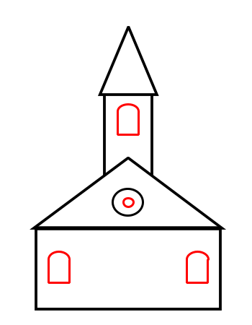
HTML is Like … CSS is Like…
Notes:
Its just like building a house using lego bricks. We have all done this when we are kids. Do you remember we use all different types of blocks as each block had a certain color and shape which could be used to build some part of the house. For example some blocks are used for building roofs while some are used for building walls, others are used for building floors. The same is true with websites. When you build a website, you use different elements according to their ideal destination. This is where HTML comes into picture. We use different tags in HTML to build this overall structure of your website.

Slide 6

Lego Bricks
Notes:
Similarly to have the same color and size for all lego bricks would make the house look ugly and dull. So to make it look more real and attractive we use colors and right shape for the lego bricks. This is where CSS or Cascading Stylesheet comes into picture. We will discuss about CSS in the later sessions.

Slide 7

Front End Development
Notes:
Advantages of HTML5
Cleaner Code: HTML5 enables web designers to write cleaner code by replacing div tags with semantic HTML5 elements
Stylish Forms: There are different types of inputs, search and different fields for different purpose.
Stability: As websites will adopt the new HTML5 elements we will see more consistency in terms of HTML used to code a web page on one site compared to another. This will make it much easier for designers and developers to immediately understand how a web page is created.
Rich Media Elements: HTML5 has an inbuilt capability to play audio and video and so we can bid goodbye to those plugin tags.
Offline Application Cache: HTML5 offers an offline application cache facility which will load the page the user has visited even if the user is temporarily offline. This feature will help the files to load much faster and reduces load on server.

Slide 8
Our Final Website
Final Project
About the Site:
ICT Academy of Kerala Training Site
Number of Pages: 3
Home
About
Services

Slide 9
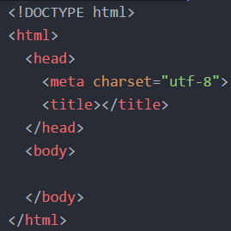
Basic Structure of HTML
Notes:
A simple example, we look at this markup here, see there are a lot of things that are really instructions to the client saying this is an HTML document, there's the body and head section.
Now lets discuss about each element:
We look at an HTML document, we've got a very simple example here, we have at the top a doctype. And the doctype is a declaration in your document of which version of the HTML standard you're following. So here you can see we're following the HTML4, we have the strict in there. There are a variety of different document standards that you can follow including XHTML which is HTML4 but all documents are valid XML documents as well. So the doctype is there and tells any client which standard we're following. We follow that by an HTML root element which is our single top level element that's going to wrap our document. All of our other pieces are going to be contained inside of that. We have the head that is really where we're going to provide a lot of meta data almost exclusively used by the clients or the browsers. So we'll provide information that's here, we've got the title, we can provide meta data, we can provide links to related documents be those style sheets, script, if we're talking about a document with many pages we might be linking to a previous or next page as well. So all that information can be used by the browser but with the exception of title you almost never see that information represented in the page. And finally of course we have the body, this is where we put our document data. This is what the user's going to see, this is where the bulk of our markup happens and where we focus on the information that we want to present to the user.
Using !DOCTYPE:
The <!DOCTYPE> declaration is not an HTML tag; it is an instruction to the web browser about what version of HTML the page is written in. In HTML 4.01, the <!DOCTYPE> declaration refers to a DTD, because HTML 4.01 was based on SGML. The DTD specifies the rules for the markup language, so that the browsers render the content correctly. HTML5 is not based on SGML, and therefore does not require a reference to a DTD.
Tips: The <!DOCTYPE> declaration is NOT case sensitive.
The Head Element:
The <head> element is a container for all the head elements. The <head> element can include a title for the document, scripts, styles, meta information, and more.
The following elements can go inside the <head> element: <title> (this element is required in an HTML document) <style> <base> <link> <meta> <script> <noscript>
Differences Between HTML 4.01 and HTML5
In HTML 4.01 the <head> element is required. In HTML5, the <head> element can be omitted.
The Body Element:
The <body> tag defines the document's body. The <body> element contains all the contents of an HTML document, such as text, hyperlinks, images, tables, lists, etc.
Differences Between HTML 4.01 and HTML5
All layout attributes are removed in HTML5. Eg: alink, background, bgcolor, link, text, vlink

Slide 10
New Elements in HTML5
<article>
<header>
<footer>
<section>
<aside>
<nav>
<progress>
Many More...
<dialog>
Notes:
Tag Description
<article> Defines an article in a document
<header> Defines a header for a document or section
<footer> Defines a footer for a document or section
<aside> Defines content aside from the page content
<progress> Represents the progress of a task
<nav> Defines navigation links
<dialog> Defines a dialog box or window
<section> Defines a section in a document

Slide 11
HTML Forms
<body>
<form action=”url”></form>
</body>
<form>
<input type=”text” name=”username”/><br>
<input type=”password” name=”password”/>
</form>
Notes:
HTML forms are used to collect information from the user. Forms are defined using the <form> element, with its opening and closing tags. Use the action attribute to point to a webpage that will load after the user submits the form.
The method attribute specifies the HTTP method (GET or POST) to be used when forms are submitted.
<form action=”url” method=”GET”>
<form action=”url” method=”POST”>
Note: When you use GET, the form data will be visible in the page address. Use POST if the form i updating data, or includes sensitive information(passwords). POST offers better security because the submitted data will not be visible in the page address.
The name attribute specifies a name for a form. To take in user input, you need the corresponding form elements, such as text fields. The <input> element has many variations, depending on the type attribute, It can be text, apssword, radio, url, submit, etc.

Slide 12
HTML Forms
<form>
<input type=”radio” name=”gender” value=”male”/>Male<br>
<input type=”radio” name=”gender” value=”female”/>Female<br>
</form>
<form>
<input type=”checkbox” name=”gender” value=”1”/>Male<br>
<input type=”checkbox” name=”gender” value=”2”/>Female<br>
</form>
Notes:
If we change the input type to radio, it allows the user select only one of a number of choices.
The type “checkbox allows the user to select more than one option.”

Slide 13
HTML Forms
<input type=”submit” value=”Submit”/><br>
Notes:
The submit button submits a form to its action attribute.

Slide 14
HTML Styling-Paragraph
<html>
<head>
<title>First Page</title>
</head>
<body>
<p>This is a paragraph</p>
<p>This is second paragraph</p>
</body>
</html>
Notes:
To create a paragraph, simply type in the <p> element with its opening and closing tags.

Slide 15
HTML Styling-Text Formatting
<b> bold text </b>
<big>big text</big>
<i>italic text</i>
<small>small text</small>
<strong>strong text</strong>
<sub>subscripted text</sub>
<sup>superscripted text</sup>
<ins>inserted text</ins>
<del>deleted text</del>
Notes:
In HTML there is a list of elements that specify text style. Formatting elements were to display special types of text.

Slide 16
HTML-Block Level Elements
<div>Hello</div>
<div style="background-color:black;color:white;padding:20px;"> <h2>London</h2> <p>London is the capital city of England. It is the most populous city in the United Kingdom, with a metropolitan area of over 13 million inhabitants.</p> </div>
<div>World</div>
<span>Hello</span>
Notes:
Every HTML element has a default display value depending on what type of element it is. The default display value for most elements is block or inline. A block-level element always starts on a new line and takes up the full width available (stretches out to the left and right as far as it can).
Inline Elements
An inline element does not start on a new line and only takes up as much width as necessary.
The <div> Element
The <div> element is often used as a container for other HTML elements.
The <div> element has no required attributes, but style, class and id are common.

Slide 17
HTML Styling-Images
<img src=”image.jpg” height=”150 px”width=”150 px” border=”1px” alt=”alttext” />
Notes:
The <img> tag is used to insert an image. It contains only attributes, and does not have a closing tag. The image’s url can be defined using the src attribute. Incase the image is not displayed the alt attribute specifies an alternate text that describes the image in words. The alt attribute is required. To define the image size, use teh width and height attributes. The value can specified in pixels or as a percentage. By default, an image has no borders. Use the border attribute withing the image tag to create a border around the image.

Slide 18
HTML Styling-Links
<a href=”filelocation”>Name of Link</a>
<a href=”filelocation” target=”_blank”>Name of Link</a>
Notes:
Links are also an integral part of every web page. You can add links to text and images that will enable the user to click on them in order to be directed to another file or webpage. In HTML links are defined using <a> tag. Use href attribute to define the link’s destination address. The target attribute specifies where to open the linked document. Giving a _blank value to your attribute will have the link open in a new window or a new tab.

Slide 19
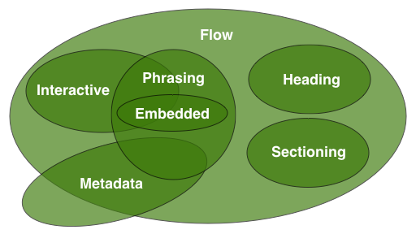
HTML 5 – Content Model
Notes:
In HTML, elements typically belonged in either the block level or inline content model. In HTML5 introduces seven main methods.
Metadata: Content that setups the presentation or behavior of the rest of the content. These elements are found in the head of the document.
<base>
<link>
<meta>
<noscript>
<script>
<style>
<title>
Embedded: Content that imports other resources into the document.
<audio>
<video>
<canvas>
<iframe>
<img>
<math>
<object>
<svg>
Interactive: Content specifically intended for user interaction.
<a>
<audio>
<video>
<button>
<details>
<embed>
<iframe>
<img>
<input>
<label>
<object>
<select>
<textarea>
Heading: Defines a section header
<h1>
<h2>
<h3>
<h4>
<h5>
<h6>
<hgroup>
Phrasing: This model has a number of inline level elements in common with HTML4
<img>
<span>
<strong>
<label>
<br>
<small>
<sub>
Flow Content: Contains the majority of HTML5 elements that would be included in the normal flow of the document.
Sectioning content: Defines the scope of headings, content, navigation, and footers.
<article>
<aside>
<nav>
<section>

Slide 20
HTML 5 – header
<div id=”header”> // in HTML 4
<!DOCTYPE html> // in HTML 5
<html>
<head></head>
<body>
<header>
<h1>This is a paragraph</h1>
</header>
</body>
</html>
Notes:
In HTML5, a simple <header> tag is used, instead.
The <header> element is appropriate for use inside the body tag.

Slide 21
HTML 5 – footer
<footer>…. </footer>
Notes:
The footer element is also widely used. Generally we refer to a section located at the very bottom of the webpage as the footer.
Tips: The following information is usually provided between these tags:
Contact information
Privacy Policy
Social Media Icons
Terms of Service
Copyright information
Sitemap and Related Documents

Slide 22
HTML 5 – <nav>
<nav>
<ul>
<li> <a href=”#”>Home</a> <li>
<li> <a href=”#”>Services</a> <li>
<li> <a href=”#”>About Us</a> <li>
<ul>
</nav>
Notes:
This tag represents a section of a page that links to other pages or to certain sections within the page. This would be section with navigation links.
Tip:
Not all of the links in a document should be inside a <nav> element. The <nav> element is intended only for major blocks of navigation links. Typically, the <footer> element often has a list of links that don’t need to be in a <nav> element.

Slide 23
HTML 5 – <article>
<article>
<h1>The article title</h1>
<p>Content of the article element</p>
</article>
Notes:
Article is a self-contained, independent piece of content that can be used and distributed separately from rest of the page or site. This could be a forum post, a magazine or newspaper article, a blog entry, a comment, an interactive widget or gadget, or any other independent piece of content.
The <article> element replaces the <div> element that was widely used in HTML4, along with an id or class.
Tip: When an <article> element is nested, the inner element represents an article related to the outer element. For example, blog post comments can be <article> elements nested in the <article> elements nested in the <article> representing the blog post.

Slide 24
HTML 5 – <section>
<article>
<h1>The article title</h1>
<section>
<p>Content</p>
<section>
</article>
Notes:
<section> is a logical container of the page or article. Sections can be used to divide up content within article.
For example, a homepage could have a section for introducing the company, another for news items, and still another for contact information.
Each <section> should be identified, typically by including a heading (h1-h6 element) as a child of the <section> element

Slide 25
HTML 5 – <aside>
<article>
<h1>The article title</h1>
<aside>
<p>Content</p>
<aside>
</article>
Notes:
<aside> is secondary or tangential content which could be considered separate from but indirectly related to the main content. This type of content is often represented in sidebars.
When an <aside> tag is used within an <article> tag, the content of the <aside> should be specifically related to that article.
Tip: When an <aside> tag is used outside of an <article> tag, its content should be related to the surrounding content.

Slide 26
HTML 5 – audio
<audio src=”audio.mp3” controls>Audio Element</audio>
<audio controls autoplay loop>
<source src=“audio.mp3” type=“audio/mpeg”>
Audio element not supported by your browser
</audio>
Notes:
Before HTML5, there was no standard for playing audio files on a webpage. The HTML5 <audio> element specifies a standard for embedding audio in a web page. The HTML5 <audio> element specifies a standard for embedding audio in a web page.
Controls
Specifies that audio controls should be displayed(such as play/pause button, etc)
Autoplay
When this attribute is defined, audio starts playing as soon as its ready, without asking for the visitor’s permission.
Loop
This attribute is used to have the audio replay every time it is finished.
Tip: The text between the <audio> and </audio> tags will display in browser that do not support the <audio> element.

Slide 27
HTML 5 – video
<video controls autoplay loop>
<source src=“audio.mp3” type=“video/mp4”>
Video is not supported by your browser
</audio>
Notes:
The video element is similar to the audio element. You can specify the video source url using an attribute in a video element, or using source elements inside the video element
Another aspect shared by both audio and video elements is that each ahs controls, autoplay and loop attributes.
Tip: Another aspect that audio and video elements have in common is that the major browsers do not all support the same file types. IF the browser does not support the first video type, it will try the next one.

Slide 28
HTML 5 – Progress Bar
Status: <progress min=”0” max=”100” value=”35”></progress>
Notes:
The <progress> element provides the ability to create progress bars on the web. The progress element can be used within headings, paragraphs , or anywhere else in the body.
Progress Element Attributes
Value: Specifies how much of the task has been completed
Max: Specifies how much work the task requires in total.
Tip: Use the <progress> tag in conjunction with javascript to dynamically display tasks progress.

Slide 29
HTML 5 – Web Storage API
Store data on a user’s local computer.
Advantages of Web Storage:
More Secure
Faster
Stores a larger amount of data
Stored data is not sent with every server request
Notes:
In HTML 5 web storage , websites can store data on user’s local computer. Before HTML5 , we had to use JavaScript cookies to achieve this functionality.
Types of Web Storage Objects
sessionStorage()
Session Storage is destroyed once the user closes the browser
localStorage()
Local Storage stores data with no expiration date.
The syntax for web store for both local and session storage is very simple and similar. The data is stores as key/value pairs.
Storing a Value:
localStorage.setItem(“key1”,”value1”);
Getting a Value:
alert(localStorage.getItem(“key1”));
Removing a Value:
localStorage.removeItem(“key1”);
Removing all Values:
localStorage.clear();
Tip: The same syntax applies to the session storage, with one difference: instead of localStorage , sessionStorage is used.
Tip: Local Storage is per domain. All pages from one domain can store and access the same data.

Slide 30
HTML 5 – Geolocation API
navigator.getLocation.getCurrentPosition();
Notes:
In HTML 5, the GeoLocation API is used to obtain the user’s geographical location. Since this can compromise user privacy, the option is not available unless the user approves it.
Tip: Geolocation is much more accurate for devices with GPS, like smartphones.
The Geolocation API’s main method us getCurrentPosition, which retrieves the current geopgraphic location of the user’s device.
Parameters

Slide 31
HTML5-Forms
<form>
<label> Your Name: </label>
<input id=”user” name=”username” type =”text”/>
</form>
<form>
<label for=“email”> Your e-mail address </label>
<input type=”text” name=”email” placeholder =“email@example.com” autofocus/>
</form>
Notes:
HTML5 brings many features and improvements to web form creation. There are new attributes and input types that were introduced to help create better experiences for web users.
HTML5 has introduced a new attribute called placeholder. On <input> and <textarea> elements, this attribute provides a hint to the user of what information can be entered into the field.
The autofocus attribute makes the desired input focus when the form loads.

Slide 32
HTML5-Forms
<form autocomplete=“off”>
<label for=“email”> Your e-mail address </label>
<input type=”text” name=”email” required/>
<input type=”submit” value=”Submit”/>
</form>
Notes:
The form will not be submitted without filling in the required fields.
Tip: The autocomplete attribute specifies whether a form or input field should have autocomplete tuned on or off. When autocomplete is on, the browser automatically complete values based on values that the user has entered before.
HTML5 added several new input types:
color
date
datetime
datetime-local
email
month
number
range
search
tel
time
url
week
New Input Attributes in HTML5:
autfocus
form
formaction
formenctype
frommethod
formnovalidate
formtarget
height and width
list
min and max
multiple
pattern
placeholder
required
step

Slide 33
HTML5- Search Box
<input id=”mysearch” name=”searchItem” type=“search”/>
<input id=”car” type=”text” list=“colors”/>
<datalist id=“colors”>
<option value=“Red”>
<option value=“Green”>
</datalist>
Notes:
The new search input type can be used to create a search box.
The <datalist> tag can be used to define a list of pre-defined options for the search field.

Slide 34
ICT Academy of Kerala
Building the Nation’s Future
Formatting with CSS

Slide 35

Cascading Style Sheet
Introduction
What is CSS ?
Advantages of CSS
Notes:
CSS is the acronym for "Cascading Style Sheet“.it is is a simple design language intended to simplify the process of making web pages presentable.
CSS handles the look and feel part of a web page. CSS was invented by Håkon Wium Lie on 1994 and maintains through a group called CSS Working Group.
Advantages:-
CSS saves time − You can write CSS once and then reuse same sheet in multiple HTML pages.
Pages load faster − If you are using CSS, you do not need to write HTML tag attributes every time. Just write one CSS rule of a tag and apply it to all the occurrences of that tag.
Easy maintenance − To make a global change, simply change the style, and all elements in all the web pages will be updated automatically.
Offline Browsing − CSS can store web applications locally with the help of an offline catche.Using of this, we can view offline websites.
Platform Independence − The Script offer consistent platform independence and can support latest browsers as well.

Slide 36
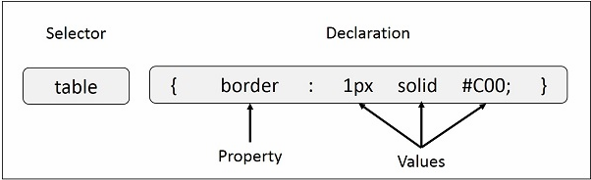
CSS Syntax
CSS Syntax
Selector
Property
Value
selector { property: value }
Notes:
So we have learned about CSS now let us check the syntax of CSS. Which is very important to write CSS rules.
A CSS comprises of style rules which is made up of three components
1. Selector:- A selector is an HTML tag at which a style will be applied. Eg :<h1>,<table> etc
2. Property - A property is a type of attribute of HTML tag eg: color,border etc
3. Values: - Values are assigned to properties. Eg: color=“blue”

Slide 37
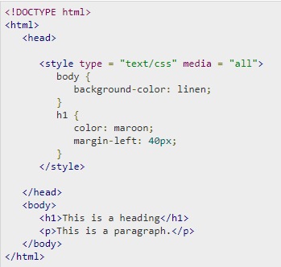
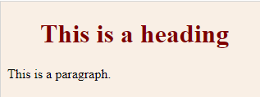
CSS Inclusion
Embedded CSS - <style> element.
<style> attributes (type,Media)
It will produce the following result
Notes:
SO we heave learned CSS and its syntax now let us add these rules to a html file so that we can make use of them.
So far we have learned what is CSS and its syntax, So let us learn how to use them in an html file.
The most commonly used methods are inline CSS and External CSS.
We can add CSS rules into an HTML document using the <style> element.
This tag is placed inside <head>...</head> tags. All these rules will be applied to all the elements available in the document.
Figure explain the use of embedding CSS into an html file.
The attributes used with <style> tag are
Type :- it can have values text/css which defines style sheet language as a content-type, and is a required property.
Media:This is an optional attribute. It can have values like screen,tty,tv,projection,handheld, print,braille,aural,all. And
this specifies the device the document will be displayed on. Default value is all.

Slide 38
CSS Inclusion-Continued
Inline CSS
Syntax:<element style = "...style rules....">
Eg: <h1 style = "color:#36C;"> This is inline CSS </h1>
External CSS
<link type = "text/css" href = "..." media = "..." />
CSS rules overriding
Notes:
Inline CSS:- Here we can specify the styling within the element tag using style attribute of that element.
Syntax:<element style = "...style rules...."> , eg:- <h1 style = "color:#36C;"> This is inline CSS </h1>
External CSS : We can use <link> tag for specifying the external styles sheet to our html file. External style sheet is a text file with .css extension.All the style rules can be specified inside this css file. We can add these files to any of our html file. Type, href and media are the attributes associated with <link> tag. Here href attribute accept a url value that specifies the location of this CSS file. Rest of the attributes are same as that of style sheet.
Rules Overriding: This is a rule of thump used when we used mutltiple method to specify the CSS properties.
1. Any inline style sheet takes highest priority. So, it will override any rule defined in <style>...</style> tags or rules defined in any external style sheet file.
2. Any rule defined in <style>...</style> tags will override rules defined in any external style sheet file.
3. Any rule defined in external style sheet file takes lowest priority, and rules defined in this file will be applied only when above two rules are not applicable.

Slide 39
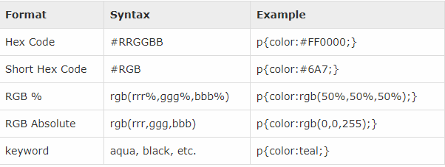
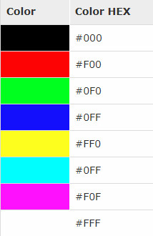
CSS - Colors
Color Values
https://htmlcolorcodes.com/
https://www.tutorialspoint.com/html/html_color_code_builder.htm
Notes:
Learn about CSS - Measurement Units (Self study).
So Now we how to create css file how to add rules to them and now we will learn about colors which is an important element in styling, we know colors are the core element to make the web page more attractive. So let us learn a bit about colors and how we can use them in css to make the web page attaractive.
CSS uses color values to specify a color. Typically, these are used to set a color either for the foreground of an element (i.e., its text) or else for the background of the element.
Hex Codes: A hexadecimal is a 6 digit representation of a color. The first two digits(RR) represent a red value, the next two are a green value(GG), and the last are the blue value(BB). Each hexadecimal code will be preceded by a pound or hash sign '#'.
Eg: #000000 = black Colour, #FFFF00=Yellow
Short Hex Codes: This is a shorter form of the six-digit notation. Here the replicated value of each components of hex codes are removed to produce a 3 digit code. Eg: #000 = black, #FF0=Yellow
RGB Values: Herecolor value is specified using the rgb( ) property. This property takes three values, one each for red, green, and blue. The value can be an integer between 0 and 255 or a percentage. All the browsers does not support rgb() property of color so it is recommended not to use it.
Eg: rgb(0,0,0) =Black, rgb(255,255,0) = Yellow

Slide 40
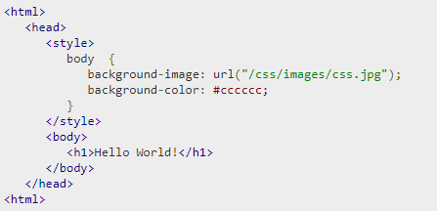

CSS - Backgrounds
background-color
background-image
background-repeat
background-position
background-attachment
background
Notes:
Here we will learn how to set background properties of an element.
The background-color property is used to set the background color of an element.
The background-image property is used to set the background image of an element.
The background-repeat property is used to control the repetition of an image in the background.
The background-position property is used to control the position of an image in the background.
The background-attachment property is used to control the scrolling of an image in the background.
The background property is used as a shorthand to specify a number of other background properties.

Slide 41
CSS – Exercise-1
Learn about CSS - Measurement Units (Self study).
Set the background color of the site you have created earlier to “#D6EAF8”
Set Header background colour to “#73C6B6”
Set header link colour to white. (use hex codes)
Set header link hover color to “#16A085”
Notes:
body{
background-color: #D6EAF8;
}
header{
background: #73C6B6;
}
header a{
color: #ffffff;
}
header a:hover{
color:#16A085;
}

Slide 42
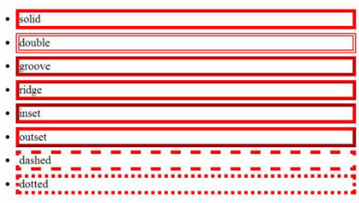
CSS - Border
border-color
bottom,top,left,right
border-style
bottom,top,left,right
border-width
bottom,top,left,right
Notes:
The border properties allow you to specify how the border of the box representing an element should look.
The border-color specifies the color of a border.
The border-style specifies whether a border should be solid, dashed line, double line, or one of the other possible values.
The border-width specifies the width of a border.
All three properties have bottom,top,left,right properties too. So that we can change individually top, bottom, left and right properties.
The border-color property allows you to change the color of the border surrounding an element.
border-bottom-color changes the color of bottom border.
border-top-color changes the color of top border.
border-left-color changes the color of left border.
border-right-color changes the color of right border.
The border-style property allows you to select one of the following styles of border −
none: No border. (Equivalent of border-width:0;)
solid: Border is a single solid line.
dotted: Border is a series of dots.
dashed: Border is a series of short lines.
double: Border is two solid lines.
groove: Border looks as though it is carved into the page.
ridge: Border looks the opposite of groove.
inset: Border makes the box look like it is embedded in the page.
outset: Border makes the box look like it is coming out of the canvas.
hidden: Same as none, except in terms of border-conflict resolution for table elements.
Also we can individually change the style of the bottom, left, top, and right borders of an element
border-bottom-style changes the style of bottom border.
border-top-style changes the style of top border.
border-left-style changes the style of left border.
border-right-style changes the style of right border.

Slide 43
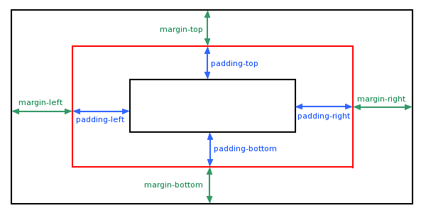
CSS - margin
margin
margin-bottom
margin-top
margin-left
margin-right
Notes:
The margin property defines the space around an HTML element. It is possible to use negative values to overlap content.
The values of the margin property are not inherited by the child elements.
The margin specifies a shorthand property for setting the margin properties in one declaration.
The margin-bottom specifies the bottom margin of an element.
The margin-top specifies the top margin of an element.
The margin-left specifies the left margin of an element.
The margin-right specifies the right margin of an element.

Slide 44
CSS - Padding
padding
padding-bottom
padding-top
padding-left
padding-right
Notes:
The padding property allows you to specify how much space should appear between the content of an element and its border
The padding serves as shorthand for the preceding properties.
The padding-bottom specifies the bottom padding of an element.
The padding-top specifies the top padding of an element.
The padding-left specifies the left padding of an element.
The padding-right specifies the right padding of an element.
The padding serves as shorthand for the preceding properties.

Slide 45
CSS –Height/Width
The height sets the height of an element's content area similarly The width sets the width
The possible values are
length, percentage, auto.
Notes:
The height sets the height of an element's content area similarly The width sets the width
length − Any length unit. Negative length values are not permitted for this property.
percentage − The height is calculated with respect to the height of the element's containing block, assuming that the containing block's height has been explicitly set.
auto − Default. The browser calculates the actual height.

Slide 46
CSS – Exercise-2
Set Header link font size to 16px
Set body font to Helvetica,sans-serif
Set bottom of header bottom with solid 3px with color #229954
Set heading padding 30px on top and header height 70px
Also add padding to header li 20px left and right

Slide 47
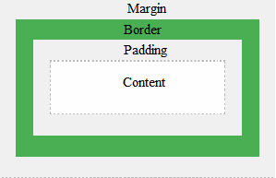
CSS –Box model
Margin
Border
Padding
Content
Notes:
The CSS box model is essentially a box that wraps around every HTML element. It consists of: margins, borders, padding, and the actual content.
Content - The content of the box, where text and images appear
Padding - Clears an area around the content. The padding is transparent
Border - A border that goes around the padding and content
Margin - Clears an area outside the border. The margin is transparent

Slide 48
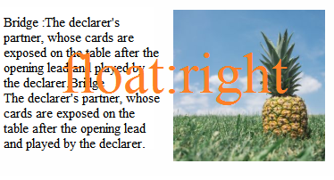
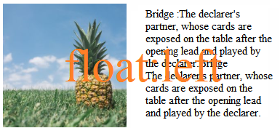
CSS –float,display,text
Float : used to wrap text around images
left,right,none,inherit
Display: property specifies if/how an element is displayed.
block,inline,none
Notes:
The float property can have one of the following values:
left - The element floats to the left of its container
right- The element floats to the right of its container
none - The element does not float (will be displayed just where it occurs in the text). This is default
inherit - The element inherits the float value of its parent
Eg: img { float: right; }
In its simplest use, the float property can be used to wrap text around images.
Display:This property specifies if/how an element is displayed.default display value depending on what type of element it is. The default display value for most elements is block or inline. Hiding an element can be done by setting the display property to none(A mothod commonly used in javascripts)
Eg: a { display: block; }

Slide 49
CSS –text
text: used for text formatting properties .
Color: used to color the texts
text-align: it is used to set the horizontal alignment of a text. A text can be left or right aligned, centered, or justified.
text-decoration : This property is used to set or remove decorations from text
Notes:
Example;
It is almost self explanatory please try it your self.
body { color: blue;
text-align: center;
letter-spacing: 3px;
line-height: 1.8; }
h2 { text-decoration: line-through;
text-transform: uppercase;
text-indent: 50px;
}

Slide 50
CSS –font, align
Font:- font-family, font-style, font-weight, font-size
Align: left,right,center
Notes:
Font: used to set fonts of a content.
The font family of a text is set with the font-family property.
The font-family property should hold several font names as a "fallback" system. If the browser does not support the first font, it tries the next font, and so on.
Eg:
p { font-family: "Times New Roman", Times, serif; }
The font-style property is mostly used to specify italic text.
This property has three values:
normal - The text is shown normally
italic - The text is shown in italics
oblique - The text is "leaning" (oblique is very similar to italic, but less supported)
The font-size property sets the size of the text.
The em size unit is recommended by the W3C rather than px.
The default text size in browsers is 16px.(1em = 16px)
i.E pixels/16=em
The font-weight property specifies the weight of a font:
font-weight: normal;
font-weight:bold;
The text size can be set with a vw unit, which means the "viewport width".
That way the text size will follow the size of the browser window:
<h1 style="font-size:15vw">Hello World</h1>

Slide 51
Thank you
Now we had learned basic CSS tobecame a beginner in web designing.
Please complete the assignments and read the advanced topic to became an expert.
Notes:
The extra topics are covered in the LMS.

Slide 52


